Slide 1
Virus Strains
Corbin Matamoros

Slide 2
Itinerary
Quick facts
What is a virus?
How does a virus behave?
How are viruses classified?
How have viruses faired throughout history?
How can we prevent disease by virus?

Slide 3
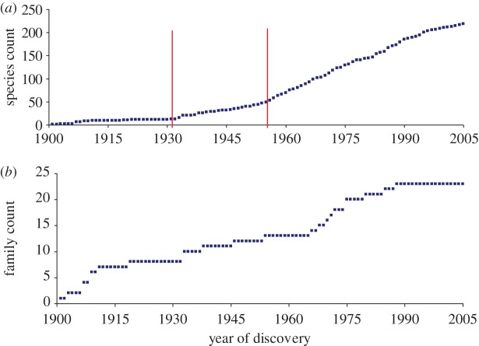
Quick facts [8]
The International Committee on Taxonomy of Viruses recognizes 219 virus species that infect humans of 30,000 [9] known ones
First of these is yellow fever (1901)
2/3 of human virus species can infect other vertebrates
We don’t know the origin of specialist human viruses
Figure: Discovery curves for human viruses
https://www.ncbi.nlm.nih.gov/pmc/articles/PMC3427559/
Notes:
Figure notes: Discovery curves for human viruses. (a) Virus discovery curve by species. Cumulative number of species reported to infect humans. Statistically significant upward breakpoints are shown (vertical lines). (b) Virus discovery curve by family. Cumulative number of families containing species reported to infect humans.

Slide 4
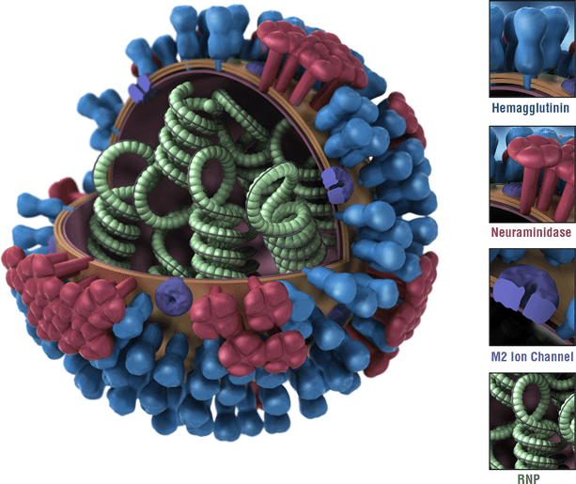
What is a virus? Part 1
A small, infectious agent that uses an organism’s cells to replicate and spread [1]
Examples:
Rabies
Influenza A, B, C, and D
HIV
Ebola
Smallpox
Picture of influenza virus https://www.cdc.gov/flu/about/viruses/types.htm

Slide 5
What is a virus? Part 2
Virus types can be divided into subtypes
Influenza A -> A(H1N1), A(H3N2), etc.
In influenza, subtypes based on hemagglutinin (H) and neuraminidase (N) [3]
Viruses can mutate and change
Antigenic drift
Antigenic shift

Slide 6
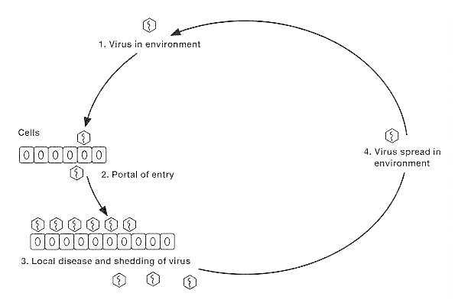
How does a virus behave? Part 1
Use a “cell’s machinery to synthesize their own nucleic acids and proteins” [2]
Causes disease by robbing a cell of its resources [2]
Target a specific tissue (i.e. display tissue tropism)
Enteroviruses -> intestine
Polioviruses -> nerve cells
Localized infection, portal of entry, and shedding
Figure 45-1 Virus spread during localized infection
Numbers indicate sequence of events.
https://www.ncbi.nlm.nih.gov/books/NBK8149/figure/A2410/?report=objectonly
Notes:
Localized infection, portal of entry, and shedding: there are some viruses that cause “infection at the portal of entry may be followed by continued local virus multiplication, leading to localized virus shedding and localized disease.” [2] For example, influenza is implanted in, spread within, lives in, and sheds from the respiratory tract.

Slide 7
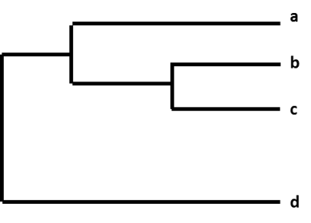
How does a virus behave? Part 2
Antigenic drift [4][5]
Random mutations of infectious agents that change antigens
Mutations compile to form different strains
Small changes -> close relationship on phylogenetic tree
Large changes -> distant relationship on phylogenetic tree
Little mutation = possible cross-protection
Large mutation = *DANGER DANGER DANGER*
A phylogenetic tree [5]
Notes:
If a virus has mutated only slightly, it’s possible it will have similar antigenic properties. Meaning, your body’s antibodies might still be able to counteract the new virus. However, if the mutations progressed enough, the body won’t recognize the new virus, and you will get sick.

Slide 8
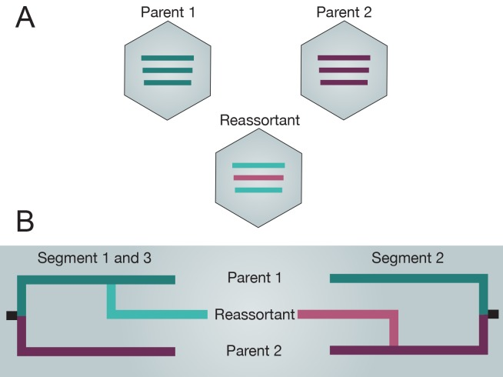
How does a virus behave? Part 3
Antigenic shift [5][6][7]
An abrupt, major change in the virus proteins (HA and/or HA and NA)
Potentially cause epidemics and pandemics
Genetic reassortment
Exclusive to segmented RNA
Segments shuffle around to produce new virus
Can happen when host infected with two subtypes
Reassortment of two tripartite genomes producing a novel reassortant. [7]
Notes:
A virus produced through antigenic shift has epidemic and pandemic potential because few humans possess immunity.

Slide 9
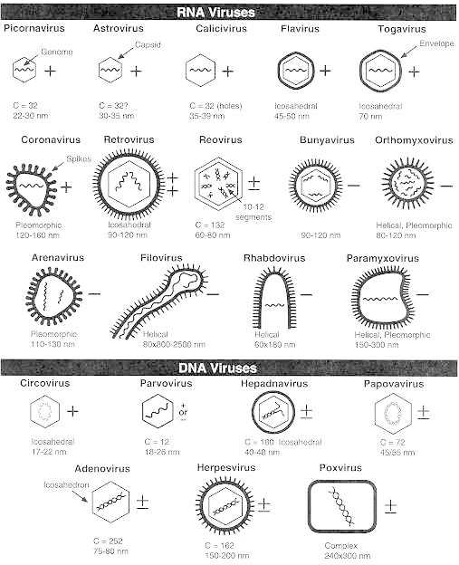
How are viruses classified? Part 1 [9]
Morphology
Helical symmetry
Icosahedral symmetry
Virus core structure
Chemical composition
RNA
DNA
Sequencing
Sanger sequencing
Next-generation sequencing (NGS)
New RDV [14]
Schemes of 21 virus families infecting humans
https://www.ncbi.nlm.nih.gov/books/NBK8174/
Notes:
Morphology:
Helical morphology is seen in nucleocapsids of many filamentous and pleomorphic viruses. Helical nucleocapsids consist of a helical array of capsid proteins (protomers) wrapped around a helical filament of nucleic acid. Icosahedral morphology is characteristic of the nucleocapsids of many “spherical” viruses. The number and arrangement of the capsomeres (morphologic subunits of the icosahedron) are useful in identification and classification. Many viruses also have an outer envelope.
Virus core structure has little known about it except in helical nucleocapsids. Small virions are simple nucleocapsids containing 1 to 2 protein species. The larger viruses contain in a core the nucleic acid genome complexed with basic protein(s) and protected by a single- or double layered capsid (consisting of more than one species of protein) or by an envelope
Chemical composition:
RNA vs. DNA: RNA viruses make up 70% of all viruses and have higher error rates (read: higher mutation rates) in the enzymes involved in RNA replication than do DNA viruses. Sense viral RNA (which can act like messenger RNA) can replicate if injected into cells. Also a part of the RNA family are DsRNA and retrovirus genomes that have two identical, plus-sense ssRNA molecules. DNA viruses contain linear dsDNA or circular DNA genomes.
Sequencing: identifying the order of nucleotides in DNA. RDV stands for rapid determination of viral RNA sequence. [14]

Slide 10
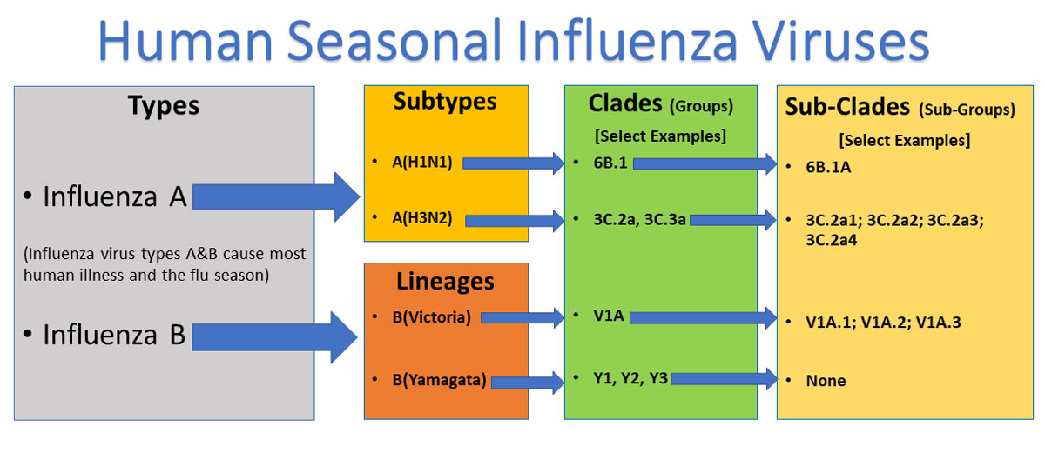
How are viruses classified? Part 2
What you’d expect: order, family, subfamily, genus, and species
We use Latinized names
Back in the day, we named after pathogenic properties
When you choose a name, make it meaningful
Several viruses of medical importance still remain unclassified.
https://www.cdc.gov/flu/about/viruses/types.htm#:~:text=There%20are%20four%20types%20of,global%20epidemics%20of%20flu%20disease.
Notes:
When you choose a name, make it meaningful: Although the current rules for nomenclature do not prohibit the introduction of new sigla, they require that the siglum be meaningful to workers in the field and be recognized by international study groups.
Several viruses of medical importance still remain unclassified. Some are difficult or impossible to propagate in standard laboratory host systems and thus cannot be obtained in sufficient quantity to permit more precise characterization. Hepatitis E virus, the Norwalk virus and similar agents (see Ch. 65) that cause nonbacterial gastroenteritis in humans are now assigned to the calicivirus family.

Slide 11
How are viruses classified? Part 3
Influenza A and B [3]
A -> 18 different hemagglutinin and 11 neuraminidase subtypes
B -> Victoria and Yamagata lineages
Further classified -> Clades and Sub-Clades
SARS-Cov-2 [10]
Severe acute respiratory syndrome coronavirus 2
Genetically related to virus from SARS 2003 outbreak
The WHO has guidelines for naming diseases [11]
No:
Geographic locations
People’s names
Fear-inciting terms (e.g. unknown, death, fatal, etc.)
Yes:
Generic descriptive terms
Specific descriptive terms like severity and age group

Slide 12
How have viruses faired throughout history?
Yellow fever [15]
Driven by sylvatic transmission
Comes in waves; makes it hard to eliminate; unknown behavior in animal population
Doesn’t reproduce as much, therefore doesn’t mutate as much [16]
Infects primates and skeeters [16]
Influenza [17]
Evolution driven by large populations, short generation times, and high mutation rates
Infects dogs, cats, humans, pigs, birds, etc.
Possible reassortment
H5N6 subtype -> H9N2 virus + H5N6 virus
Notes:
Doesn’t reproduce as much, there doesn’t mutate as much: This virus is still classified as a single serotype. It doesn’t mutate as often as, say, influenza. [16] thinks the “differences in the time spent in mosquitoes are likely to constitute the main reason for differences in evolutionary dynamics [of the virus].”
Possible reassortment: where two different viruses combine to form a new virus.

Slide 13

How can we prevent disease by virus?
Vaccines [12]
Weaken the virus (e.g. measles, mumps, chickenpox) [13]
Inactivate the virus (e.g. polio and rabies)
Use part of the virus (e.g. hepatitis B and shingles)
Contain . . .
This Photo by Unknown Author is licensed under CC BY-SA-NC
Notes:
Weaken the virus: viruses are first injected into an environment that they are not designed to infect. The lucky few who manage to infect the environment cells adapt to reproduce, but they are weakened as a result. These weakened viruses are then collected and injected into the human as a vaccine. Since the new virus had adapted to another environment, it can’t infect the human. However, it still prompts an immune system response and the body learns to defend against it. [13]
Inactivate the virus: Kill (inactivate) the virus with a chemical. This method is safer for those with weakened immune systems and cannot cause sickness, period. However, it typically requires multiple doses to become immune. [12]
Use part of the virus: a protein from the surface of the virus is used. Of course, this only works if that part of the virus is what is needed to become immune (as opposed to the whole virus being needed). This vaccine can be given to an immunocompromised individual, and immunity is achieved after two doses. [12]
Contain: preservatives (thimerosal), adjuvants (aluminum salts), stabilizers (sugars, gelatin), residual cell culture materials (egg protein), residual inactivating ingredients (formaldehyde), and residual antibiotics (neomycin).

Slide 14
Sources Part 1
[1] “Disease”. Class PowerPoint presentation.
[2] “Medical Microbiology. 4th edition”. Chapter 45. https://www.ncbi.nlm.nih.gov/books/NBK8149/
[3] “Types of Influenza Viruses”. CDC. https://www.cdc.gov/flu/about/viruses/types.htm
[4] “Antigenic drift”. Encyclopedia Britannica https://www.britannica.com/science/antigenic-drift
[5] “How the Flu Virus Can Change: “Drift” and “Shift”. CDC. https://www.cdc.gov/flu/about/viruses/change.htm
[6] “Antigenic shift”. Encyclopedia Britannica. https://www.britannica.com/science/antigenic-shift
[7] “RNA Virus Reassortment: An Evolutionary Mechanism for Host Jumps and Immune Evasion”. https://www.ncbi.nlm.nih.gov/pmc/articles/PMC4497687/
[8] “Human viruses: discovery and emergence”. https://www.ncbi.nlm.nih.gov/pmc/articles/PMC3427559/
[9] “Medical Microbiology. 4th edition”. Chapter 41. https://www.ncbi.nlm.nih.gov/books/NBK8174/
[10] “Naming the coronavirus disease (COVID-19) and the virus that causes it”. WHO. https://www.who.int/emergencies/diseases/novel-coronavirus-2019/technical-guidance/naming-the-coronavirus-disease-(covid-2019)-and-the-virus-that-causes-it#:~:text=Viruses%20are%20named%20based%20on,Viruses%20(ICTV).

Slide 15
Sources Part 2
[11] “World Health Organization Best Practices for the Naming of New Human Infectious Diseases”. 2015. WHO. https://apps.who.int/iris/bitstream/handle/10665/163636/WHO_HSE_FOS_15.1_eng.pdf;jsessionid=5B8B730B053269D11298F36ABF2C5BFC?sequence=1
[12] “Making Vaccines: How Are Vaccines Made?” CHOP. https://www.chop.edu/centers-programs/vaccine-education-center/making-vaccines/how-are-vaccines-made
[13] “Attenuation: How Scientists Made Live Vaccines – Vaccine Makers Project”. Vaccine Makers Project - Vimeo. https://vimeo.com/227180098. Video.
[14] “Rapid Genome Sequencing of RNA Viruses”. https://www.ncbi.nlm.nih.gov/pmc/articles/PMC2725858/
[15] “Tracking the evolution and transmission of yellow fever”. Science Daily. https://www.sciencedaily.com/releases/2018/08/180823141003.htm
[16] “Yellow Fever Virus Exhibits Slower Evolutionary Dynamics than Dengue Virus”. https://www.ncbi.nlm.nih.gov/pmc/articles/PMC2798388/
[17] “Evolution of Influenza A Virus by Mutation and Re-Assortment”. https://www.ncbi.nlm.nih.gov/pmc/articles/PMC5578040/

